Slide 1
Data package for HyMAX
Krishna Talluru, Liam McQuellin & Andrew Neely
Hypersonics group, UNSW Canberra.
Email for correspondence: k.talluru@adfa.edu.au

Slide 2
Input data
Run #
Cantilever plate, static shock generator at 2 degrees (mandatory) and 10 degrees (optional)
Freestream conditions
Total pressure : 980 $±$40 kPa
Total temperature: 580 $±$ 2 K
Freestream pressure: 755 $±$ 5 Pa
Freestream temperature: 75 $±$ 2 K
Model wall temperature: 300 $±$ 2 K
Mach number: 5.8 $±$ 0.06
Unit Reynolds number: 7.1 x 10⁶
HyMAX
Facility operation
Ludwieg tube at University of Southern Queensland (TUSQ), Australia
Test flow: Free jet
Test gas: Compression heated air
Flow start: Bursting of diaphragm
Flow duration: 0.2 $±$ 0.01 seconds
(Time series data of freestream pressure fluctuations will be provided on request.)
Geometry
Refer to page 3.
Sensor locations
Refer to page 4.
Notes:
STP files
Drawing sheets – 2D sketches

Slide 3
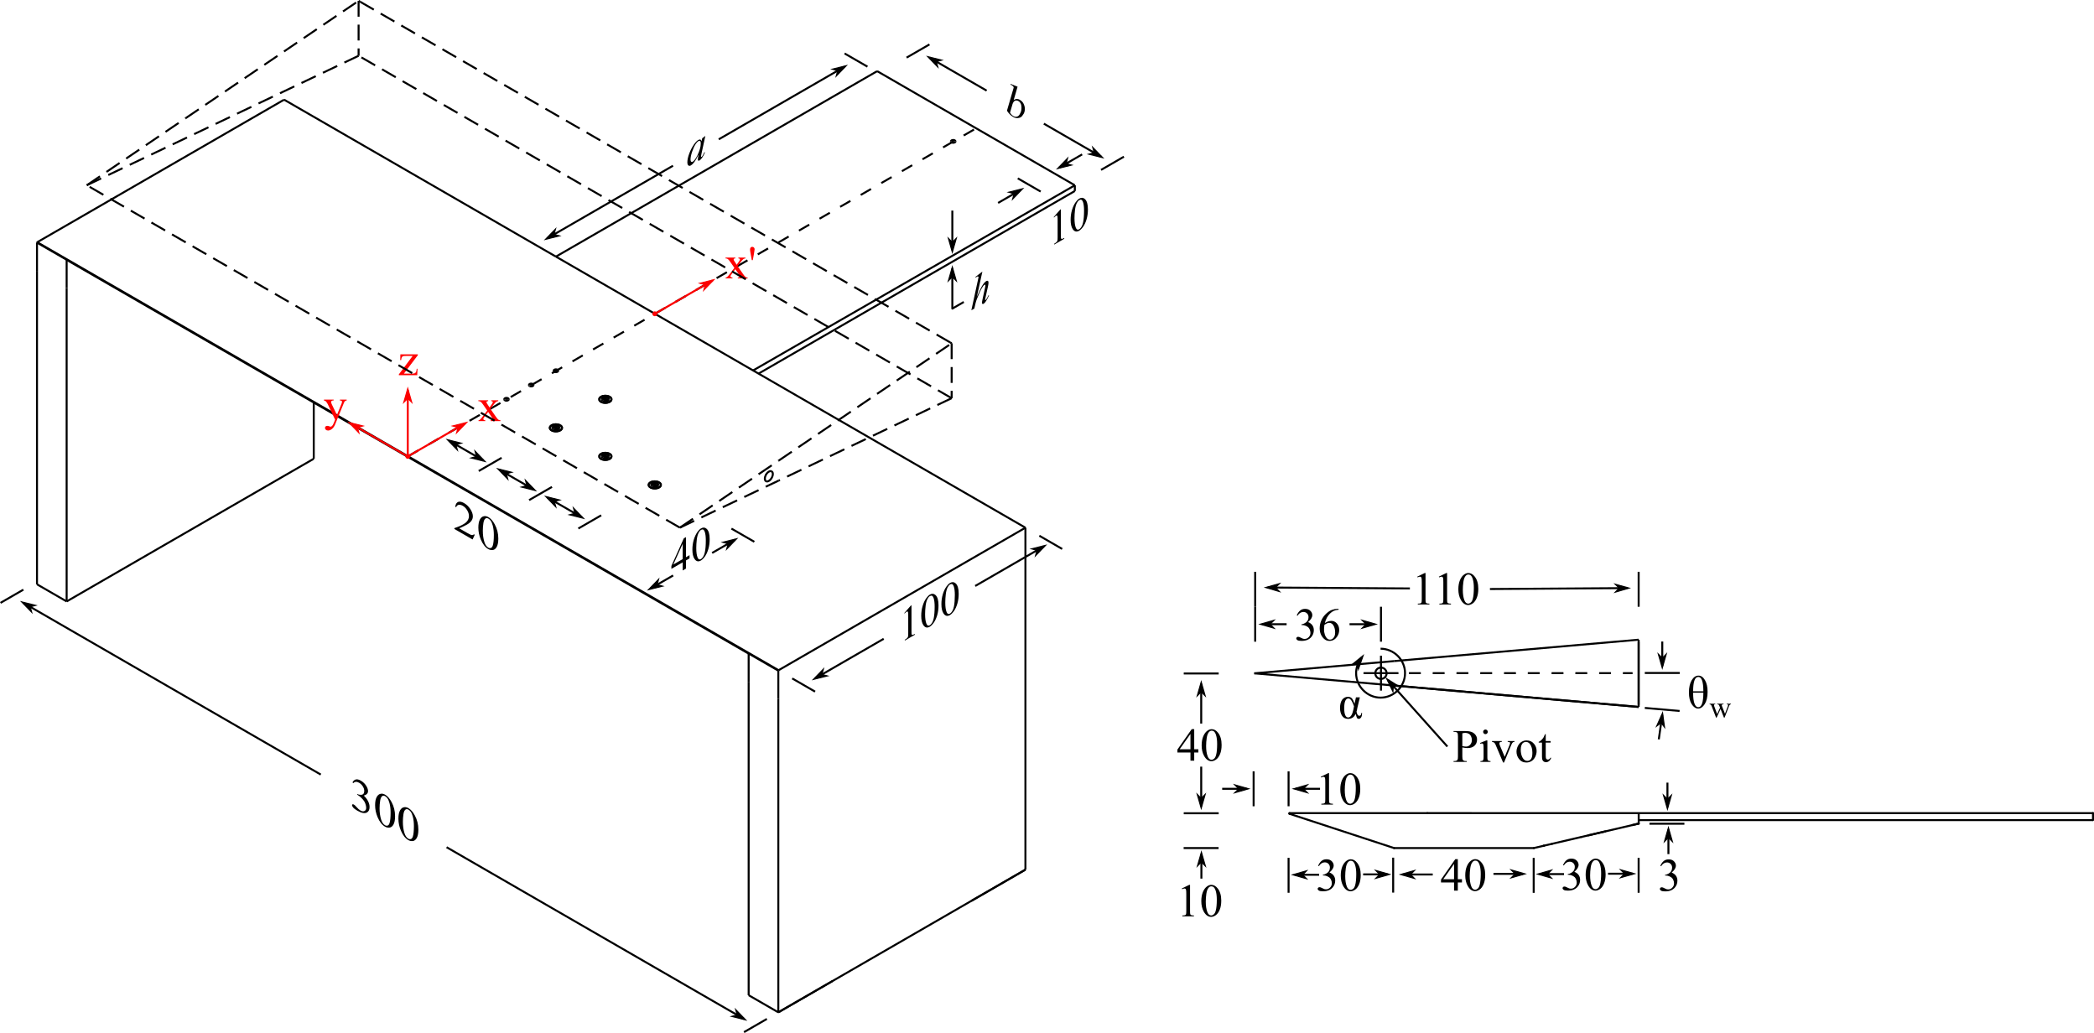
Geometry
Variable | Value
a | 130 mm
b | 80 mm
h | 2 mm
α | -3º
θ_{w} | 5º
Θ = α + θ_{w} | 2º
Shock generator
Resultant wedge angle
See the next page for the locations of pressure transducers, strain gages and thin film gages.
Note: All dimensions are in mm.
CAD files will be provided on request.
Details of the wedge geometry can be found in Currao et al., “Hypersonic Oscillating Shock-Wave/Boundary-Layer Interaction on a Flat Plate”, vol. 59, AIAA 2021.
Notes:
STP files
Drawing sheets – 2D sketches

Slide 4
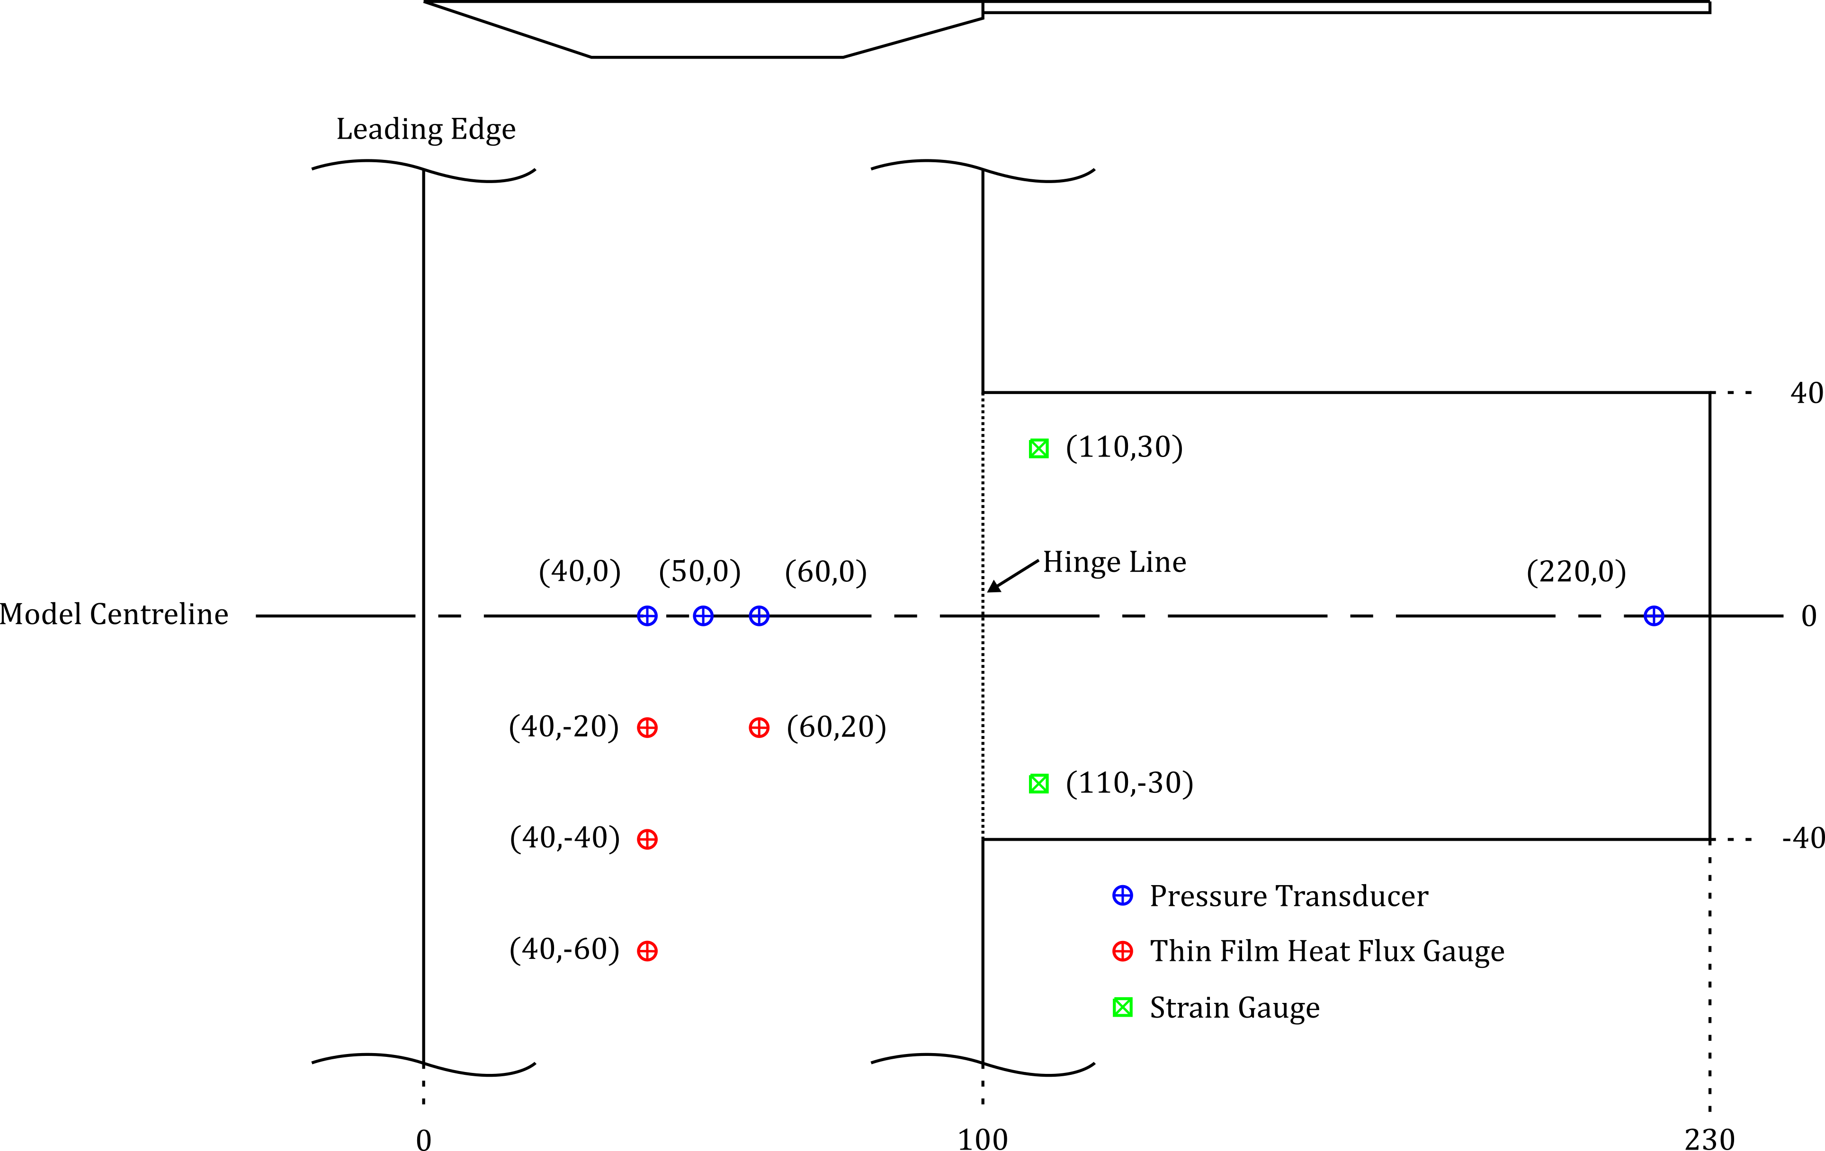
Sensor locations
(Bolted joint)
Data sets available:
1. Spatial pressure distribution history (Pressure Sensitive Paint).
2. High-speed schlieren video history (flow field structure).
3. High-speed displacement history (image tracking of schlieren).
4. Heat flux measurements from four thin film gauges on the panel.
5. Laser scanner measurements on the centerline of the cantilever plate.
6. Pressure histories from discrete sensors at four locations on the panel.
7. Strain gage measurements at two locations near the hinge line.
Note: All dimensions are in mm.
Notes:
STP files
Drawing sheets – 2D sketches

Slide 5
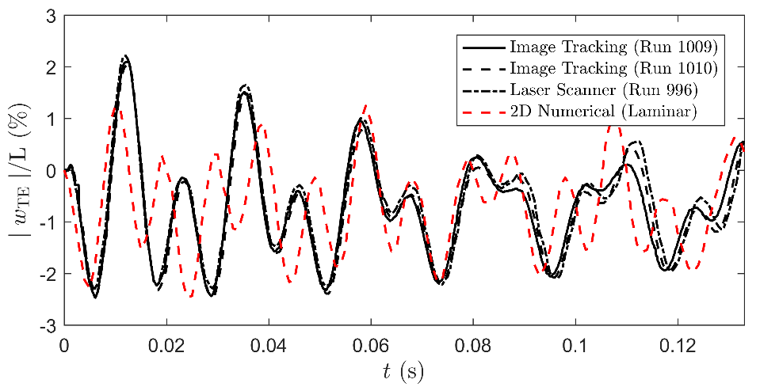
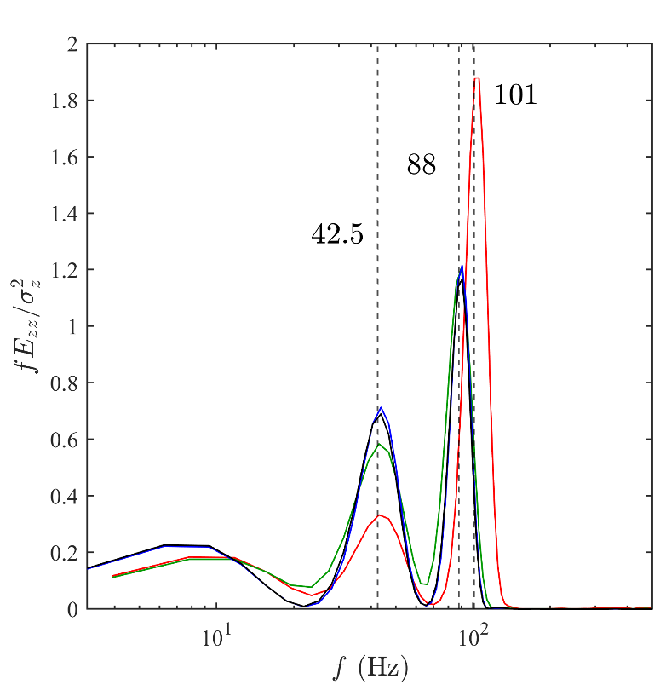
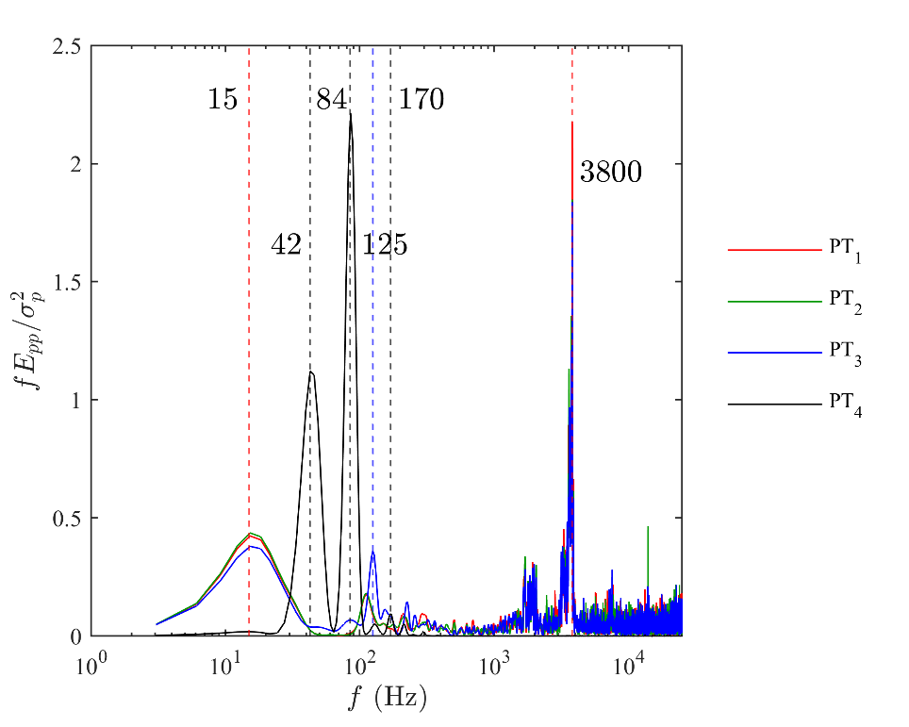
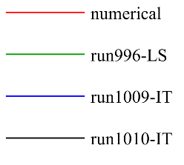
Sample data/results
Figure 1: Timeseries of displacement of the trailing edge using laser scanner, image tracking and 2D laminar simulation.
(a)
(b)
Figure 2: Power spectral density of (a) trailing edge displacement and (b) pressure fluctuations at four locations on the panel.
Notes:
STP files
Drawing sheets – 2D sketches

Slide 6
schlieren visualization
2º Static shock generator
Cantilever plate
Notes:
STP files
Drawing sheets – 2D sketches

